Slide 1
Begin Latex in Minutes
2018年春节学期
王津
2018-4-19

Slide 2
Outline
Set up for LaTeX
First LaTeX file
Multilingual usage
Lists
Paragraph and section
Making a table of contents
Footnotes
Equation
Table
Adding images
Reference

Slide 3
Set up for LaTeX
What is LaTeX?
Why use LaTeX?
LaTeX, which is pronounced «Lah-tech» or «Lay-tech» (to rhyme with «blech»), is a document preparation system for high-quality typesetting. It is most often used for medium-to-large technical or scientific documents but it can be used for almost any form of publishing.
LaTeX is free, multiplatform.
LaTeX is just a text document (which can be opened by any text editor), readily converted to PDF.
LaTeX separates content and style. Style once, then focus on content.
The workflow is faster compared to MS Word.
LaTeX is widely used for scientific topics.
LaTeX is simply the best option when it comes to typesetting math expressions.

Slide 4
Set up for LaTeX
CTEX is the best solution for using both English and Chinese.
http://www.ctex.org/HomePage
Before installation, you should backup your system PATH environment variable
右键“我的电脑”->点击“属性”->点击“高级系统设置”->点击“环境变量”->在系统变量中找到“PATH”->全选后复制粘贴到一个新建文本中。

Slide 5
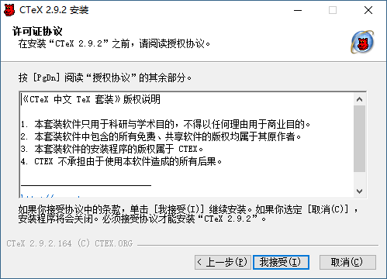
Set up for LaTeX
Installation

Slide 6
First LaTeX file
Let's do the traditional Hello World in LaTeX.
If you have installed CTEX, first open Winedt create a new file with ending .tex.
Then type in the following code below to render "Hello World!" and run “PDFTexify".
\documentclass[a4paper]{article}
\begin{document}
Hello World ! % This is your content
\end{document}

Slide 7
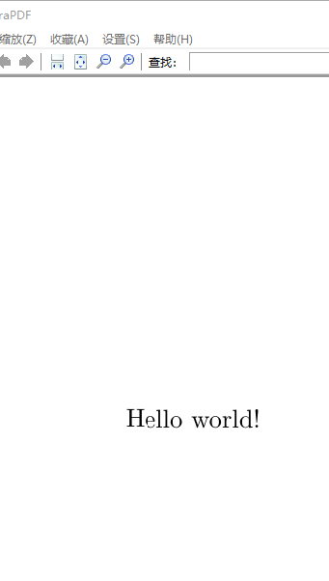
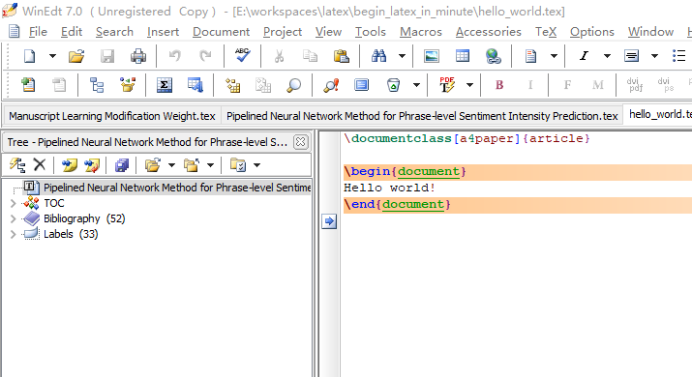
First LaTeX file

Slide 8
First LaTeX file
A deeper look into your first LaTeX file easily shows that:
The first line tells the Interpreter that you are working on an article with the size of the a4. Other types of document you might be working with in the future are report, book... and so on.
A document is wrapped by the \begin{document} and \end{document}. Think of this as the heart of the document, as the main() in java or C++... without which the document can't be rendered.
The part between begin and end ( which, in this case, is Hello World ) is simply your own content.
A percent sign (%) denotes your comment, which LaTeX will ignore.

Slide 9

First LaTeX file
Attention
Looking back at \begin{document}, \end{document}, \documentclass[a4paper]{article}. You may notice the pattern now. These are called Typesetting Commands ( which are usually preceded by “\” ) and arguments ( placed inside curly braces “{}” ). LaTeX are basically normal texts, but powered by these commands.
While you are following this guide, everything will work smoothly. However, in the future, should there be any problems, don't panic. The error reports are human-friendly and readable. If you can't resolve them, a search tool like Google may be your best friend.
Some characters are predefined with special meanings in LaTeX. You may want to use backslashes (\) in front of these characters for proper output.

Slide 10
Multilingual usage
A tricky situation is dealing with Chinese in Latex. Here, usepackage{CJKutf8} with \begin{CJK}{UTF8} and \end{CJK} comes in very handy. Here's Chinese example:
\documentclass[a4paper]{article}
\usepackage{CJKutf8}
\begin{document}
\begin{CJK}{UTF8}{min}
这是一行中文字%Thank you for reading this article.
\end{CJK}
\end{document}

Slide 11
Lists
It is very important to organize your document well. Thus, let's start by putting your items into a list.
Two common types of lists are unordered and ordered list. Each of them can be handled with ease in LaTeX document:
Unordered List Unordered list only needs "itemize".
(pun intended)
Ordered List Ordered list, however, need us to
"enumerate" them. (pun intended)
\begin{itemize}
\item Item.
\item Another Item.
\end{itemize}
\begin{enumerate}
\item First Item.
\item Second Item.
\end{enumerate}

Slide 12
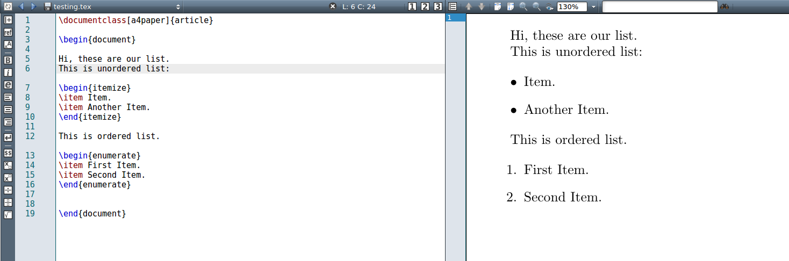
Lists
Here's how two types of list display in the output:

Slide 13
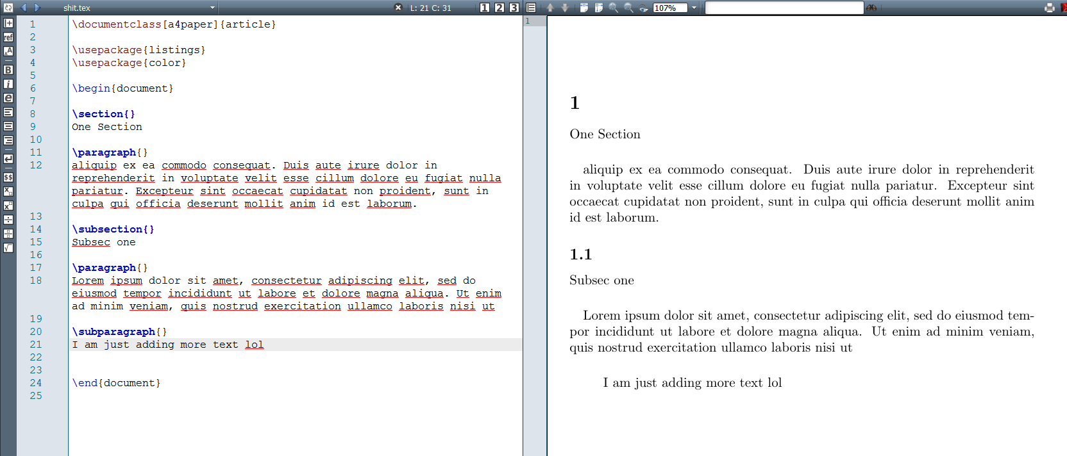
Paragraph and section
We begin a section with \section and a paragraph with \paragraph.
You can also add subsection with \subsection and subparagraph with \subparagraph

Slide 14
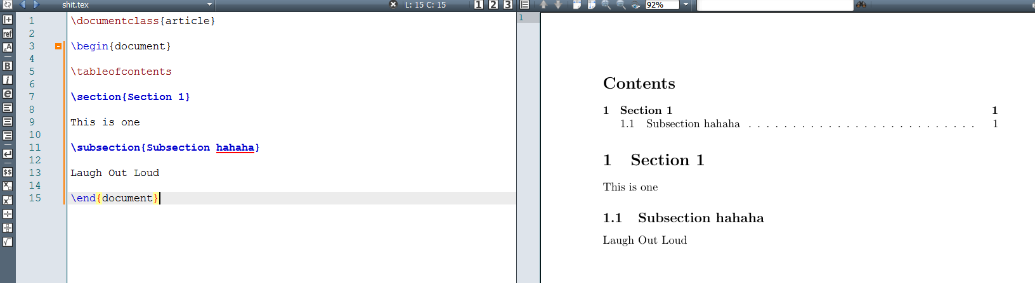
Making a table of contents
It's useful to open sections and subsections with a \tableofcontents
you can use \newpage if you want to make a new page.

Slide 15
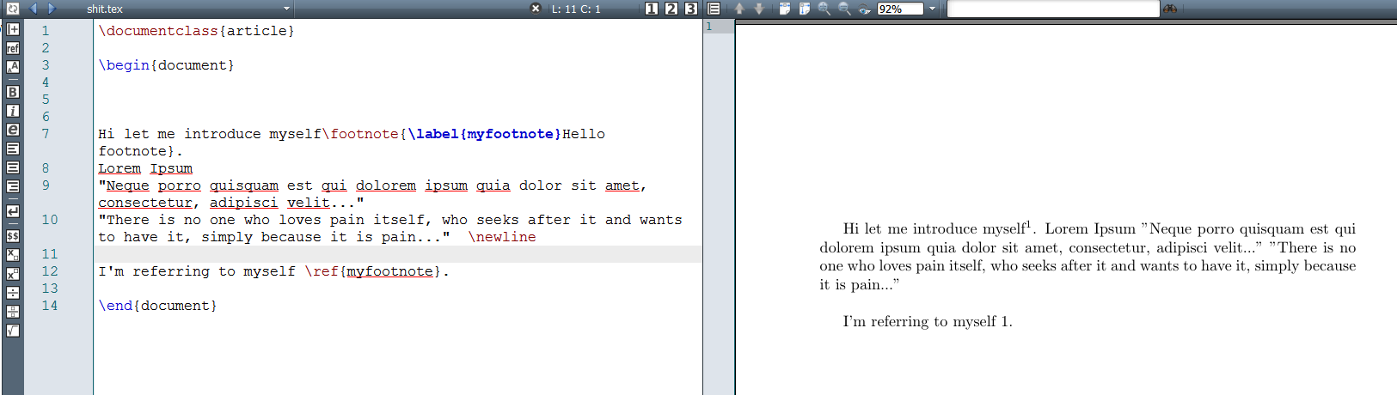
Footnotes
It's as easy as pie to use footnote+label+ref to make all kinds of footnotes you want. For example:
Hi let me introduce myself\footnote{\label{myfootnote}Hello footnote}.
... (later on)
I'm referring to myself \ref{myfootnote}.

Slide 16
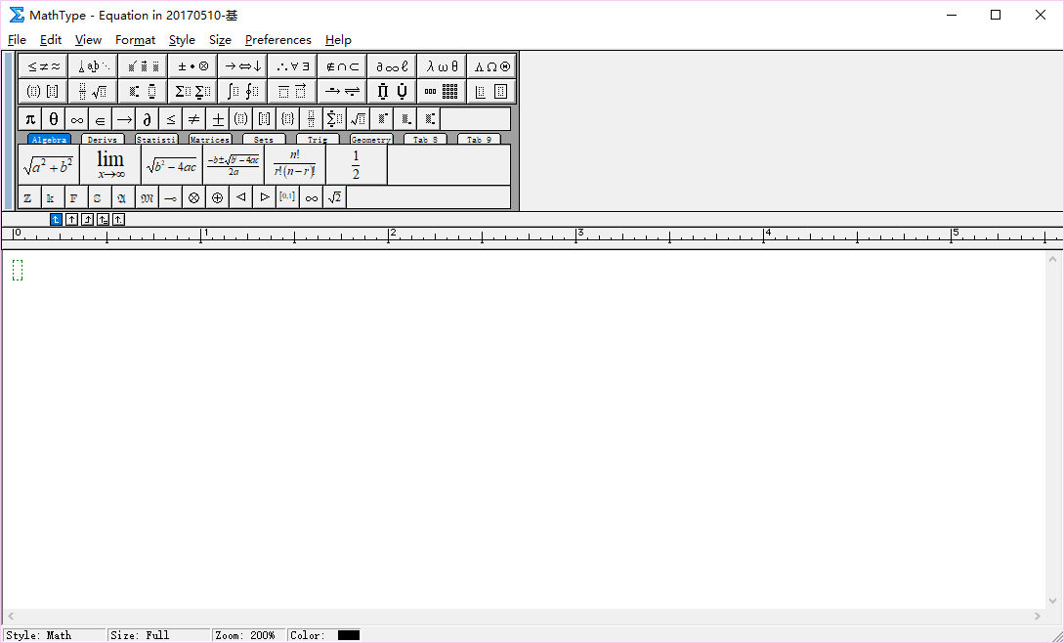
Equations
Create Equations with MathType
http://www.mathtype.cn/

Slide 17
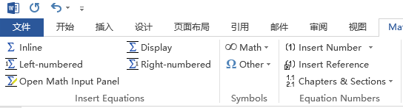
Equations
Open Word, you will find a new toolbar option
Inline
Display
Left-numbered
Right-numbered

Slide 18
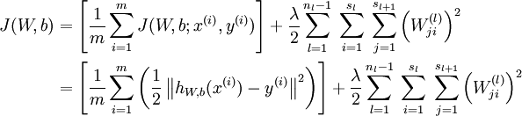
Equations
Click “Display” or “Right-numbered”
Try to display the formulation of loss function of a neural network.

Slide 19
Equations
Formulations in Latex
Inline $$
E.g. $X \in {\Re ^d}$
Right-numbered
\begin{equation}
X \in {\Re ^d}
\label{eq:1}
\end{equation}

Slide 20
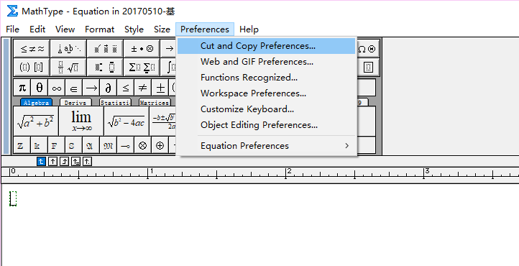
Equations
Convert the Mathtype formulation into Latex

Slide 21
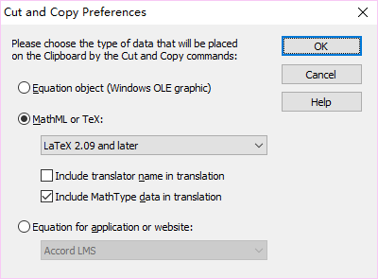
Equations
Convert the Mathtype formulation into Latex
Select the formulation in Mathtype. Copy and paste in Latex
Delete all comments and \[ \]
% MathType!MTEF!2!1!+-
% feaagKart1ev2aqatCvAUfeBSjuyZL2yd9gzLbvyNv2CaerbuLwBLn
% hiov2DGi1BTfMBaeXatLxBI9gBaerbd9wDYLwzYbItLDharqqtubsr
% 4rNCHbWexLMBbXgBd9gzLbvyNv2CaeHbl7mZLdGeaGqik8vrps0lbb
% f9q8WrFfeuY-Hhbbf9v8qqaqFr0xc9pk0xbba9q8WqFfea0-yr0RYx
% ir-Jbba9q8aq0-yq-He9q8qqQ8frFve9Fve9Ff0dmeaabaqaciGaca
% GaaeqabaWaaeaaeaqbaOqaaiaadIfacqGHiiIZcqGHCeIWdaahaaWc
% beqaaiaadsgaaaaaaa!445E!
$X \in {\Re ^d}$

Slide 22
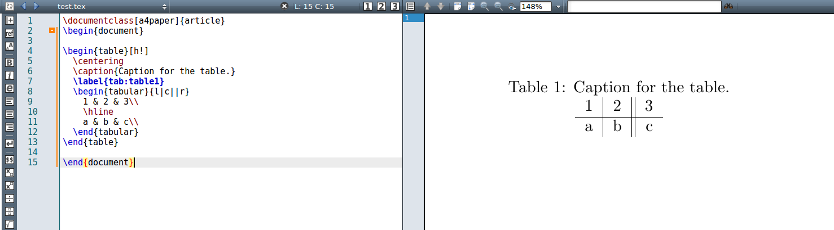
Table
\begin{table}[h!]
\centering
\caption{Caption for the table.}
\label{tab:table1}
\begin{tabular}{l|c||r}
1 & 2 & 3\\ \hline
a & b & c\\
\end{tabular}
\end{table}
A practical example

Slide 23
Table
For tables, first we need a table environment, which is why we have \begin{table} and \end{table}.
You will learn about h! later in the image section. It goes with \centering to keep the table at the center of the page.
Caption is for describing. Label is for tagging. You will see these more in image section.
Tabular is the most important part. A table environment always needs a tabular environment inside.
the part {l|c||r} is where we format the content inside the table. Here we can see:
l or c or r means that the content inside each cell will be left-aligned or center-aligned or right-aligned, respectively.
the vertical slash | or || is actually the format of the vertical lines/borders inside the table's columns.
1 & 2 & 3 => 1 2 3 are the contents of each cells. the ampersand & is used to separate the content of each cell in a row.
a \hline actually adds a horizontal line to separate each row.

Slide 24
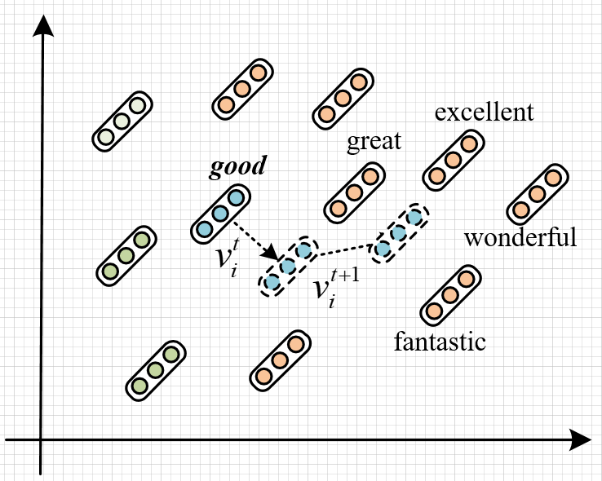
Adding Images
Use Visio to generate a paradigm figure
Use Matplotlib in python to generate a result histogram

Slide 25
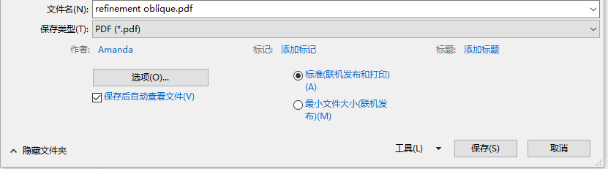
Adding Images
Save as pdf file
Cut into certain shape. (Adobe Acrobat)

Slide 26
Adding Images
To add an image to the LaTeX file, you need to use figure environment and the graphicx package. Use \usepackage{graphicx} and
‼️ Tips: Put [width=\linewidth] to scale the image to the width of the document. If you want to float the image, then you need to attribute the begin with a certain value. Also, the fig is for later reference so name it with care.
\begin{figure}[!t]
\centering
\includegraphics[width=3in]{figure2.pdf}
\caption{Image Captions.}
\label{fig_2}
\end{figure}
h (here) — same location
t (top) — top of page
b (bottom) — bottom of page
p (page) — on an extra page
! (override) — will force the specified location

Slide 27
Matplotlib
Use Matplotlib to Plot Data
Line
import matplotlib.pyplot as plt
import numpy as np
x = np.arange(9)
y = np.sin(x)
z = np.cos(x)
# marker数据点样式，linewidth线宽，linestyle线型样式，color颜色
plt.plot(x, y, marker="*", linewidth=3, linestyle="--", color="orange")
plt.plot(x, z)
plt.title("matplotlib")
plt.xlabel("height")
plt.ylabel("width")
# 设置图例
plt.legend(["Y","Z"], loc="upper right")
plt.grid(True)
plt.show()

Slide 28
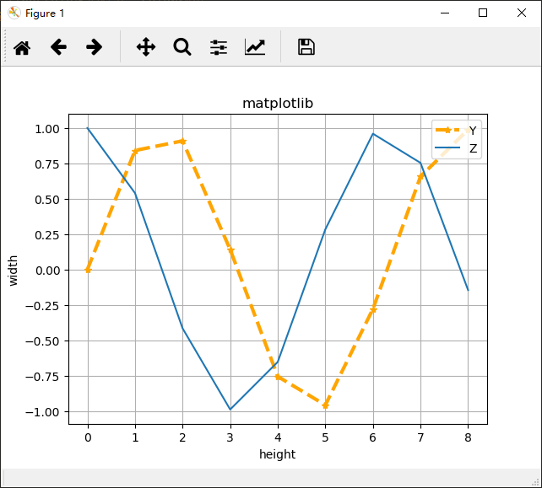
Matplotlib
Click save as
“png” or “jpeg” for word file
“pdf” for latex file

Slide 29
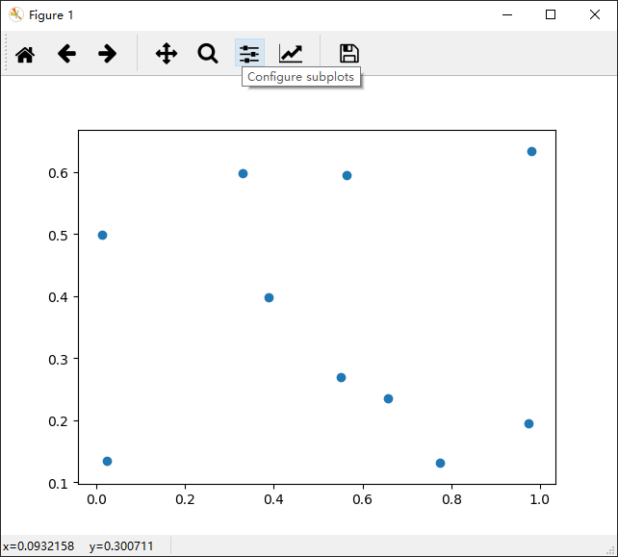
Matplotlib
Scatter plot
import matplotlib.pyplot as plt
import numpy as np
x = np.random.rand(10)
y = np.random.rand(10)
# x = (1.0, 2.0, 3.0,)
# y = (11.1, 2.23, 3.14,)
plt.scatter(x,y)
plt.show()

Slide 30
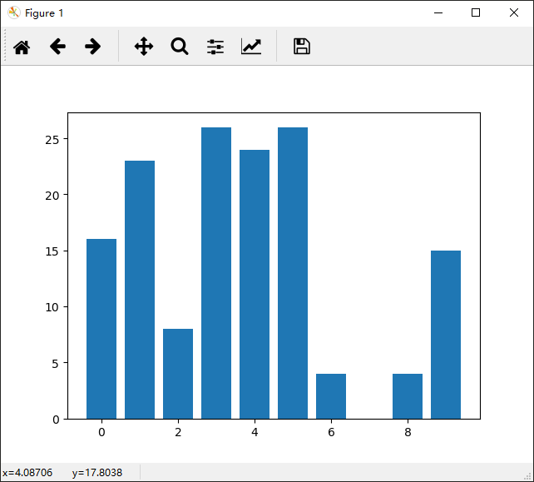
Matplotlib
Bar
import matplotlib.pyplot as plt
import numpy as np
x = np.arange(10)
y = np.random.randint(0,30,10)
plt.bar(x, y)
plt.show()

Slide 31
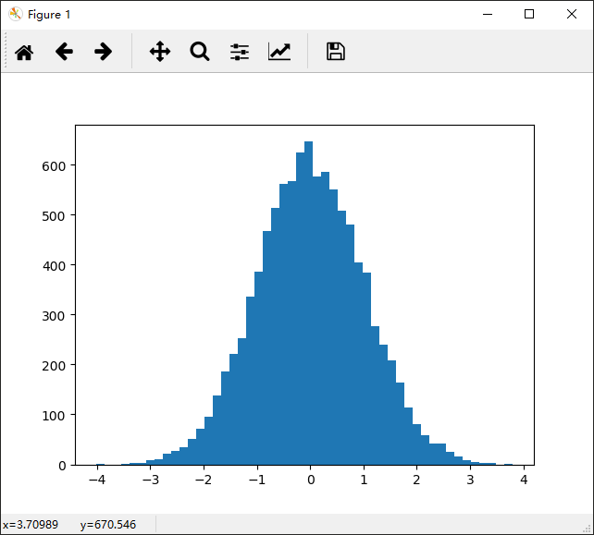
Matplotlib
Histogram
import matplotlib.pyplot as plt
import numpy as np
mean, sigma = 0, 1
x = mean + sigma * np.random.randn(10000)
plt.hist(x,50)
plt.show()

Slide 32
Matplotlib
Advanced example - bar
import numpy as np
import matplotlib.pyplot as plt
font = {'family' : 'Times New Roman', 'color' : 'black',\
'weight' : 'normal', 'size' : 20}
n_groups = 4
means_nn = (0.743, 0.720, 0.913, 0.900)
means_ecnu = (0.734, 0.686, 0.884, 0.845)
means_uwb = (0.644, 0.657, 0.846, 0.849)
means_lsis = (0.421, 0.324, 0.599, 0.462)
fig, ax = plt.subplots()
index = np.arange(n_groups)
bar_width = 0.2

Slide 33
Matplotlib
Latex math in xticks and yticks
opacity = 0.6
rects1 = plt.bar(index, means_nn, bar_width, color='b', label='NN', alpha=0.7)
rects2 = plt.bar(index + bar_width, means_ecnu, bar_width, color='r', label='L2R (ECNU)', alpha=0.7)
rects3 = plt.bar(index + 2 * bar_width, means_uwb, bar_width, color='g', label='GP-Reg (UWB)', alpha=0.7)
rects4 = plt.bar(index + 3 * bar_width, means_lsis, bar_width, color='c', label='PMI (LSIS)', alpha=0.7)
# plt.xlabel('Metrics', fontdict=font)
# plt.ylabel('Scores', fontdict=font)
# plt.title('Scores by group and gender')
plt.xticks(0.2 + index + bar_width, ('Word\n Kendall\'s $\\tau $',\
'Phrase\n Kendall\'s $\\tau $', \
'Word\n Spearman\'s $\\rho $', \
'Phrase\n Spearman\'s $\\rho $'),
family = 'Times New Roman', fontsize=13)

Slide 34
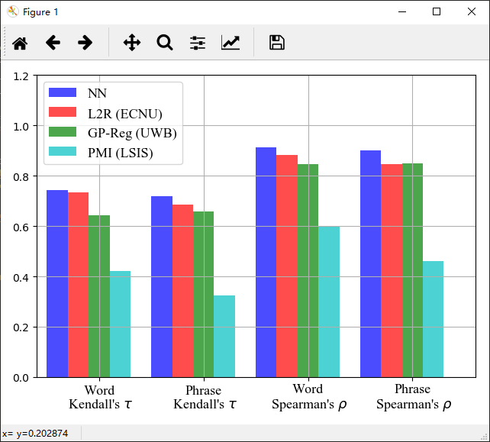
Matplotlib
plt.ylim(0, 1.2)
plt.xlim(-0.2, 4.0)
plt.legend(prop={'size': 13, 'family' : 'Times New Roman'})
plt.tight_layout()
plt.grid(True)
plt.show()

Slide 35
Matplotlib
Advanced example - line
from __future__ import absolute_import
from __future__ import print_function
import os
import sys
import logging
from matplotlib import pyplot as plt
x_topn = [1, 2, 3, 4, 5]
y_binary = [ 88.8, 89, 88.1, 87.2, 86.2]
y_finegrained = [64.8, 65.8, 64.5, 61.2, 58.8]
font = {'family' : 'Times New Roman', 'color' : 'black',\
'weight' : 'normal', 'size' : 20}
fig = plt.figure()

Slide 36
Matplotlib
Twin - x
ax1 = fig.add_subplot(111)
line1, = ax1.plot(x_topn, y_binary, 'rs-', linewidth=2.2, label='Binary')
ax1.set_xlim(0.75, 5.25)
ax1.set_ylim(85.5, 90.5)
ax1.set_ylabel('Binary (Macro-F1)', fontdict=font)
ax1.set_xlabel('$\\alpha:\\beta$', fontdict=font)
ax1.tick_params(labelsize=16)
ax1.set_yticklabels(('', '86.0', '87.0', '88.0', '89.0', '90.0'))
ax2 = ax1.twinx()
line2, = ax2.plot(x_topn, y_finegrained, 'bh-', linewidth=2.2, label='Ternary')
ax2.set_xlim(0.75, 5.25)
ax2.set_ylim(56.5, 68.5)
ax2.set_ylabel('Ternary (Macro-F1)', fontdict=font)
ax2.tick_params(labelsize=16)
ax2.set_yticklabels(('', '58.0', '60.0', '62.0', '64.0', '66.0', '68.0'))

Slide 37
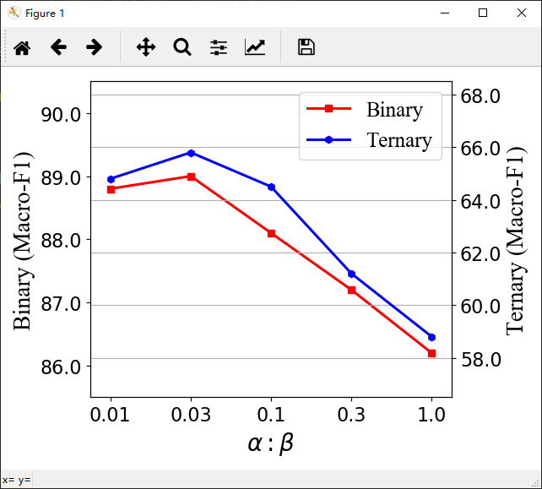
Matplotlib
Twin - x
plt.legend(handles=[line1, line2], prop={'size': 18, 'family' : 'Times New Roman'}, loc='upper right')
plt.gca().set_xticklabels(('', '0.01', '0.03', '0.1', '0.3', '1.0'))
plt.tight_layout()
plt.grid()
plt.show()

Slide 38
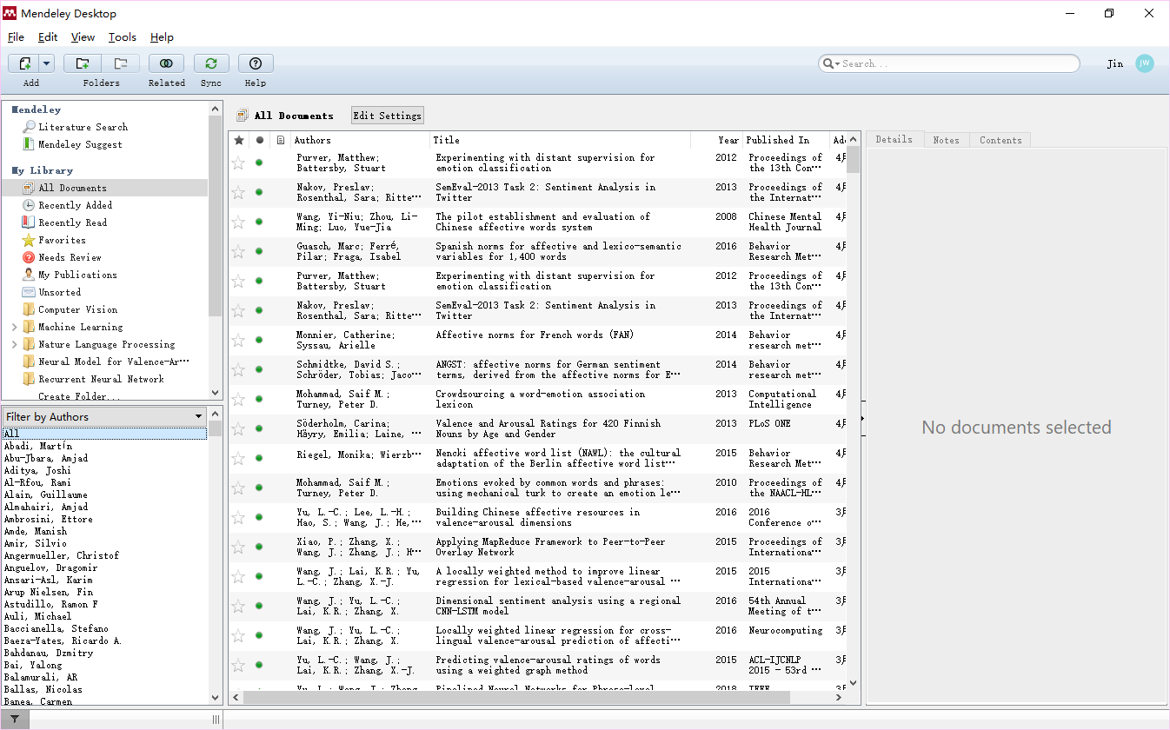
Reference
Mendeley
https://www.mendeley.com/

Slide 39

Reference
Drag a pdf paper to directly generate an item.
Revise manually to correct the information.

Slide 40
Reference
Type
Paper – 学术论文
Journal Article [J]
Conference Proceedings [C]
Book [M] - 学术专著
Book section
Report [R] - 学术报告
Thesis or Dissertation [D] - 学位论文
硕士可称Thesis
博士可称Thesis or Dissertation

Slide 41
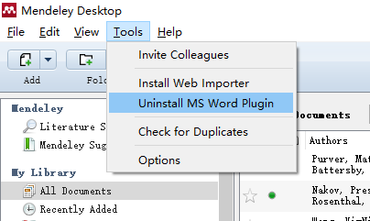
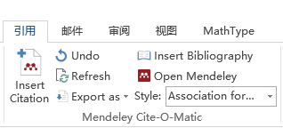
Reference
Install word plugin
Ref in word

Slide 42
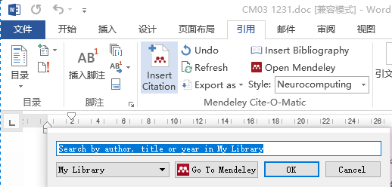
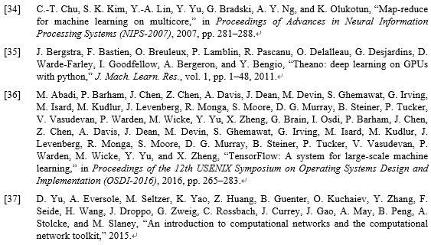
Reference
Click “Insert citation”
Click “Insert Bibliography”

Slide 43
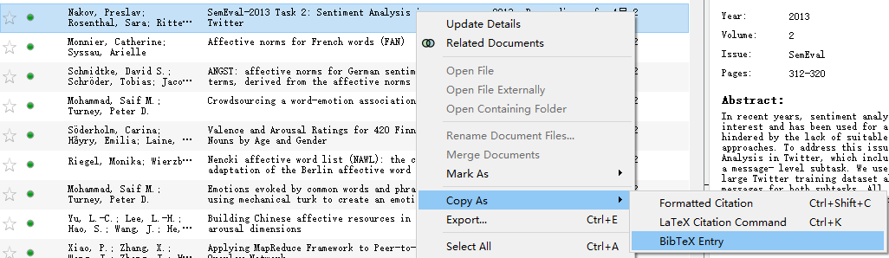
Reference
Latex
Save all ref as a bib file

Slide 44
Reference
@inproceedings{Mohammad:2018,
title={Semeval-2018 Task 1: Affect in tweets},
author={Saif M. Mohammad and Felipe Bravo-Marquez and Mohammad Salameh and Svetlana Kiritchenko},
booktitle={Proceedings of International Workshop on Semantic Evaluation (SemEval-2018)},
address = {New Orleans, LA, USA},
year={2018},
month = {June}
}
@inproceedings{Mohammad:2018b,
title={Understanding Emotions: A Dataset of Tweets to Study Interactions between Affect Categories},
author={Saif M. Mohammad and Svetlana Kiritchenko},
booktitle={Proceedings of the 11th Edition of the Language Resources and Evaluation Conference (LREC-2018)},
address = {Miyazaki, Japan},
year={2018},
month = {May}
}
@article{Mohammad2013NRC,
title={NRC-Canada: Building the State-of-the-Art in Sentiment Analysis of Tweets},
author={Mohammad, Saif M and Kiritchenko, Svetlana and Zhu, Xiaodan},
journal={Computer Science},
year={2013},
}

Slide 45
Reference
Including a bib file
Cite a reference in content
\bibliography{semeval2018}
\bibliographystyle{acl_natbib}
\cite{Li2008AdaBoost}

Slide 46
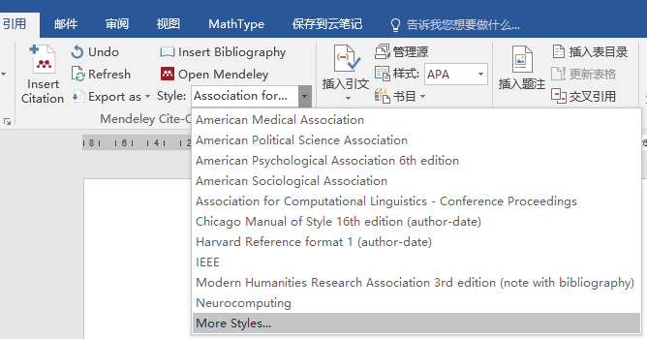
Reference
Import style 1
http://www.zotero.org/styles
Download csl file
Copy to citationStyles-1.0 folder that you install mendeley.
Import style 2
Click “More styles”

Slide 47
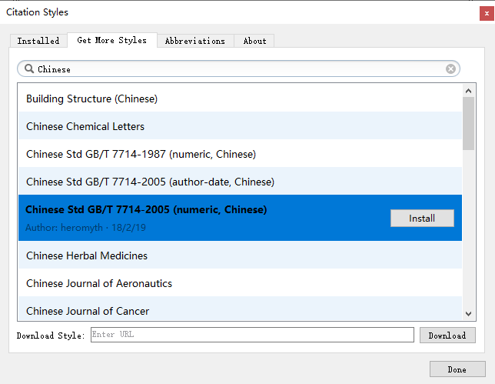
Reference
Get More Styles
Search for “Chinese Std GB/T 7714-2005 (numeric, Chinese)”
For your thesis or journal article in Chinese

Slide 48
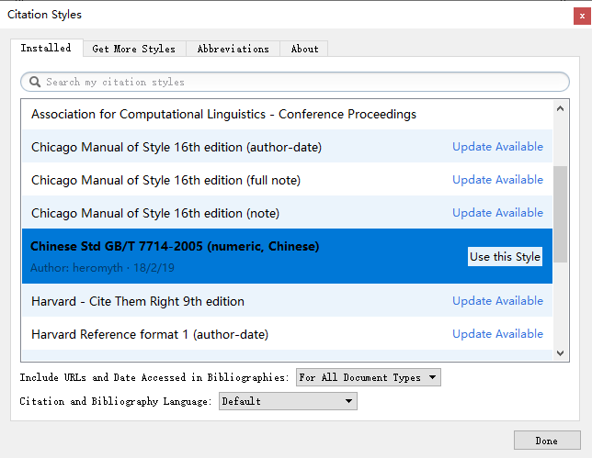
Reference
Click “Installed” tab
Click “Use this Style”

Slide 49

Using a template
Template url:
http://ieeeauthorcenter.ieee.org/create-your-ieee-article/use-authoring-tools-and-ieee-article-templates/ieee-article-templates/
The template will be also provided in every conference.

Slide 50
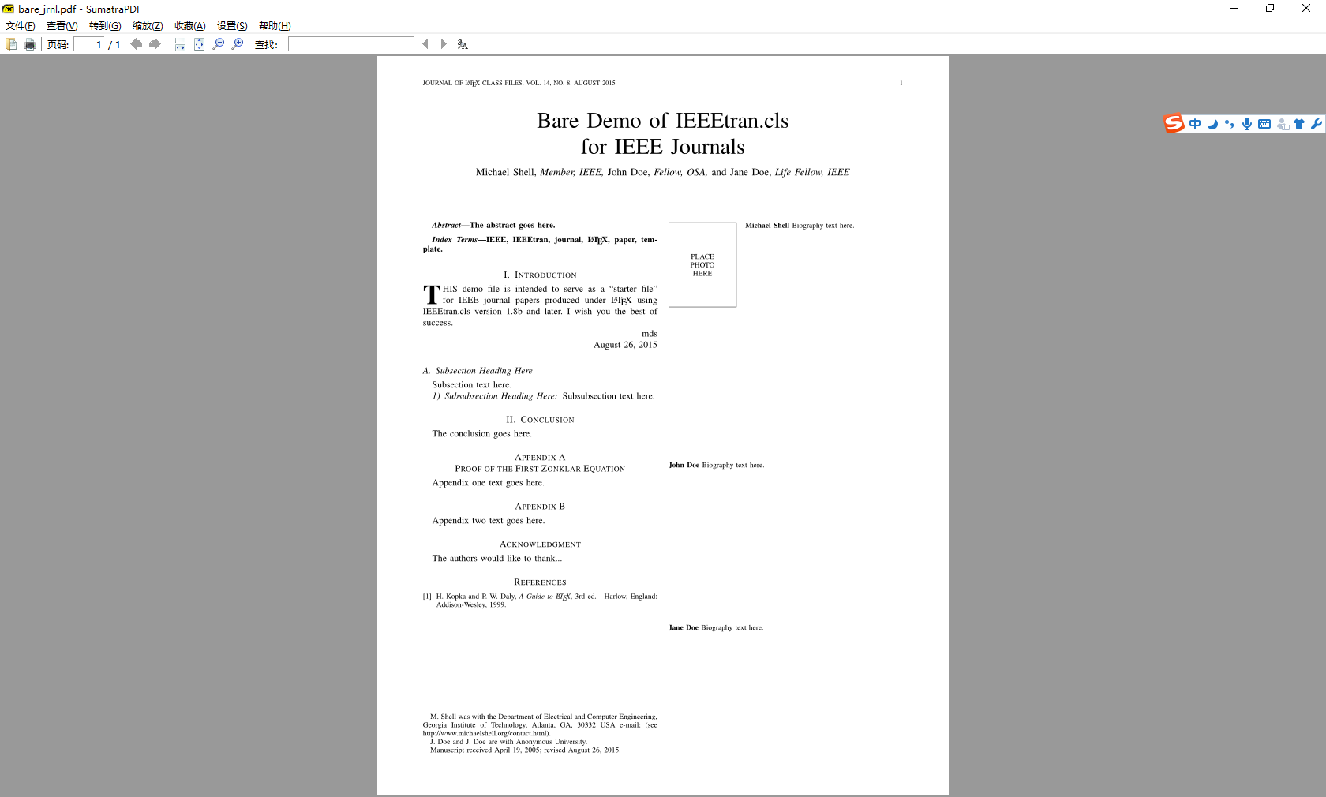
Using a template
For example, down load the IEEE Transaction template.

Slide 51
Task
By using the IEEE Trans template, formatting the following content into a scientific article:
http://deeplearning.stanford.edu/wiki/index.php/UFLDL_Tutorial
Sparse Autoencoder
Neural Networks
Backpropagation Algorithm
Gradient checking and advanced optimization
Autoencoders and Sparsity
Visualizing a Trained Autoencoder
Sparse Autoencoder Notation Summary

